Slide 1
New kernel tracer(osnoise, timerlat) to locate the latency spike
for realtime kernel latency debugging
赵 桥 - Red Hat
2023.10.28

Slide 2
Agenda
What is OS Noise
Low latency mix HPC
How OS Noise is measured
Tracer: osnoise, timerlat
Find the spike

Slide 3
What is OS Noise?
The Operating System Noise (os noise) is a well defined High Performance Computing (HPC) metric.
It is the amount of interference experienced by an application due to operating system activity.
It is generally a fine-grained metric.

Slide 4
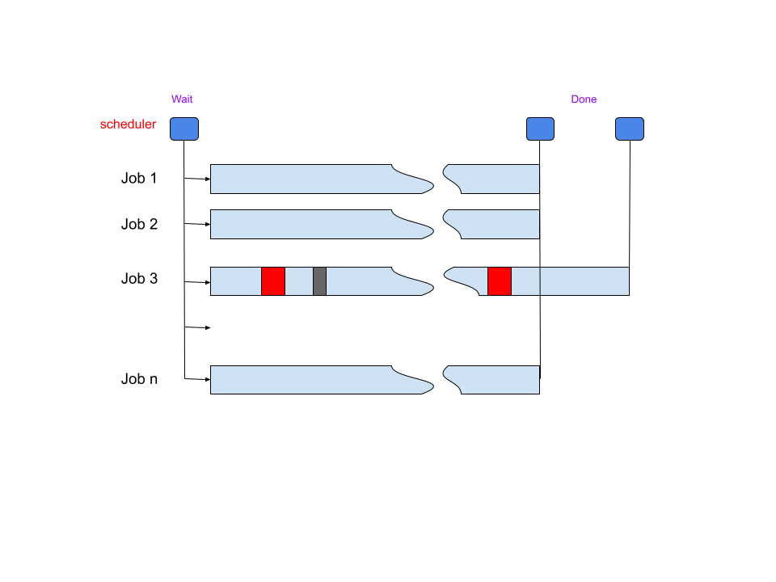
Low latency mix HPC
The OS noise, sometimes named OS jitter, is a well-known problem for the HPC field.
The problem with os noise is that the OS interference on a single job can cause a delay in the entire task.
processor-local phase
synchronization phase
operating system noise

Slide 5
Low latency mix HPC
Low latency communication are touching the sub millisecond range
Allowing low latency services in the cloud
Many new options enabled by 5G.
Linux is becoming part of the core of the network with of nfv
This work is not parallel like regular HPC, but serial among the hops.
The effect of os noise are cumulative in the round-trip time
Many provides request latency in the order of microseconds
Notes:
Stock kernel latency is about hundred mircroseconds, the expectation for a real-time kernel latency is within tens of mircroseconds

Slide 6
How OS Noise is measured
How OS noise is measured now
A tool in userspace reads the time in a loop
Computes the delta between two time reads
Report each delta > threshold as a 'jitter' or 'latency'
For the bugging, the user needs to setup a set of tracing events
The userspace tools stops the trace when hitting a 'spike'
Human interpretation of the trace

Slide 7
How osnoise is measured
Problems with current approach
Trace and the benchmark are not synchronized
Leaves gaps for interpretation and “doubts”
Require the trace of multiple event
Too much room for speculation
No clear definition of the metric
No clear method to debug it
Other tools are required for hardware/virtualization induced noise
Especially hwlat detector

Slide 8
How osnoise is measured
Solution
Improve the information given by the measuring tool
Information reasons for a given “noise” occurrence
Make the workload and the trace to be in sync
The workload and the trace needs to “atomically” in sync
Tracing automation
Define/standardize the most essential information
Reduce the amount of events passed to the user (to reduce overhand)
Do the common interpretation before “printing” the trace

Slide 9
Tracer: osnoise, timerlat
Osnoise
Osnoise is a kernel tracer that also dispatches the workload
The workload runs in kernel
The workload and the trace are synchronized
Likewise other tools, osnoise measures the time delta
But it also measures the amount of interference from OS Operations

Slide 10
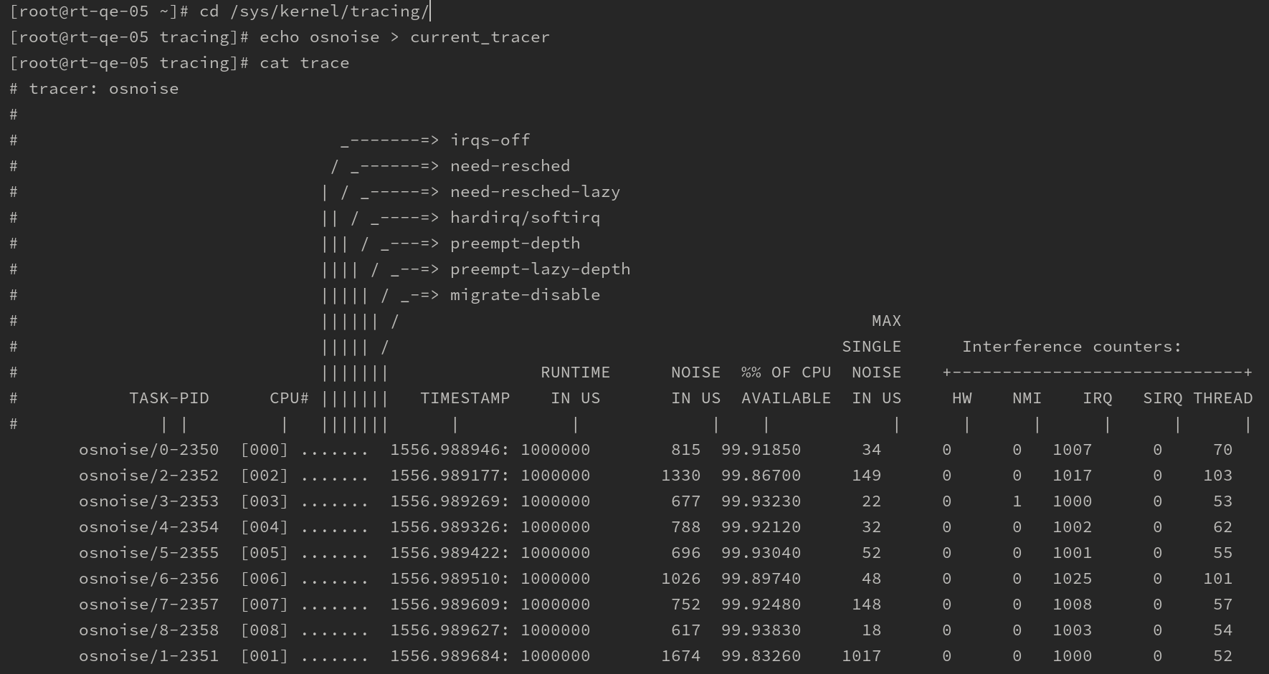
Tracer: osnoise, timerlat
Enable osnoise

Slide 11
Tracer: osnoise, timerlat
Osnoise trace config:
Configuration files in /sys/kernel/tracing/osnoise/
cpus: CPUs at watch a osnoise thread will execute
period_us: the period of the osnoise thread
runtime_us: how long an osnoise thread will look for noise in the period
stop_tracing_us: stop the system tracing if a single noise is >= than set here
stop_tracing_total_us: stop the system tracing if total noise is >= than set here
options: a set of on/off options that can be enabled by writing the option name to the file or disabled by writing the option name preceded with the 'NO_' prefix
And /sys/kernel/tracing/tracing_thresh
The minimum delta between two time() reads to be considered as noise, in us
When set to 0, the default value will be used, which is currently 5 us

Slide 12
Find the spike
What can consume the cpu time?
Linux task abstractions
NMI
IRQs
Softirqs
Threads
Hardware can interfere your task
SMIs
VMs

Slide 13
Find the spike
Osnoise tracepoint/event
To osnoise: tracepoints process all the data in kernel and in sync with the tracer
To reduce the overhead when enabled
No overhead when disabled
Events:
osnoise: sample_threshold printed anytime a noise is found, including the $ of interferences
osnoise: nmi_noise noise from NMI, including the duration
osnoise: irq_noise noise from IRQs, including the duration
osnoise: softirq_noise noise from Softirq, including the duration
osnoise: thread_noise noise from thread, including the duration

Slide 14
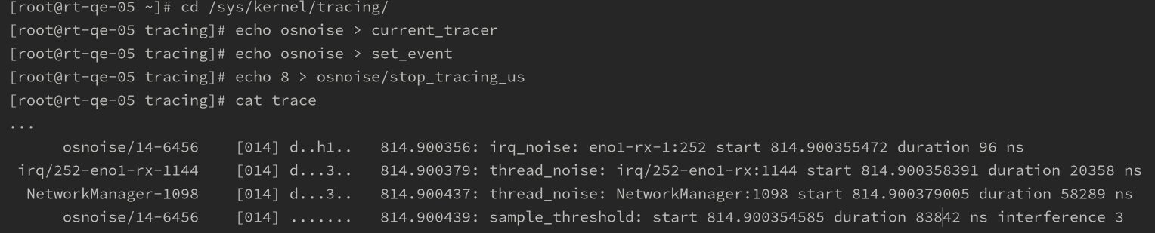
Find the spike
osnoise tracer output

Slide 15
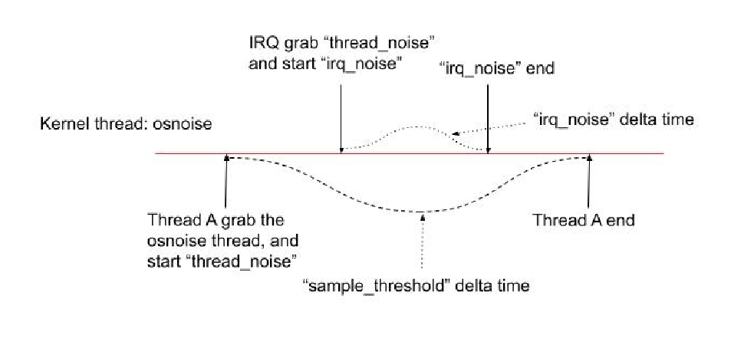
Find the spike
osnoise tracer output

Slide 16
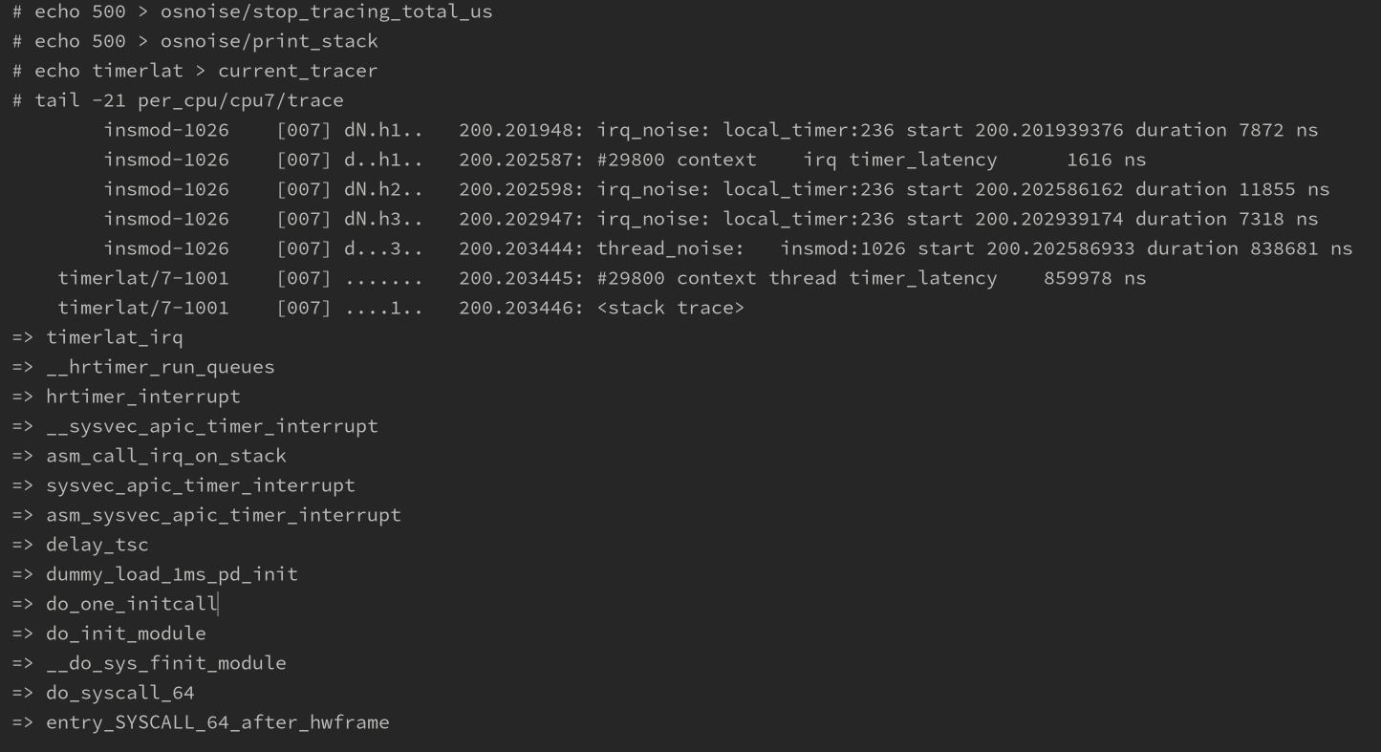
Find the spike
timerlat/osnoise output

Slide 17
Find the spike
Hardware noise
Osnoise tracks all sources of OS noise
Osnoise computes the delta time and the interference counter on every loop
When the interference counter == 0
the cause of the noise is from outside the OS
it is computed as hardware, like hwlat detector does
the hardware can be either physical or VMs

Slide 18
Find the spike
Final thoughts:
Osnoise tracer combines workload and tracer in a single tool.
Provides information and tracing that points to the root cause of OS Noise
Processing the data to reduce the overhand to a minimum
It can also be used to detect hardware latency
Timerlat tracer is osnoise’s sibling for interrupt-based latency
It is part of kernel and is enabled on recent Fedora/CentOS/RHEL
The rtla tool adds an intuitive interface for osnoise tracer

Slide 19
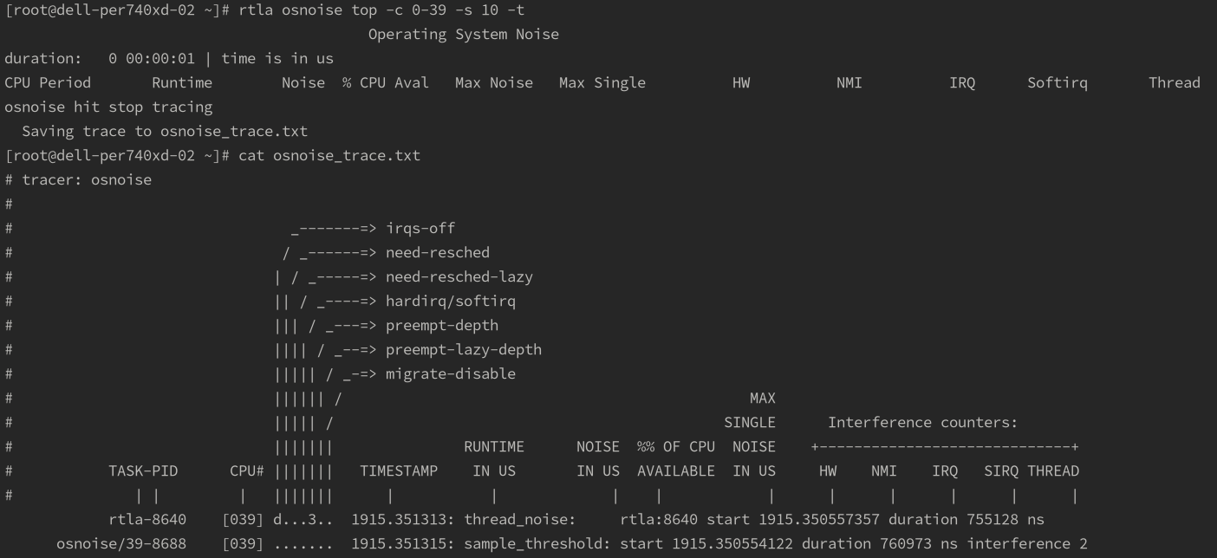
Find the spike
Userspace package rtla

Slide 20
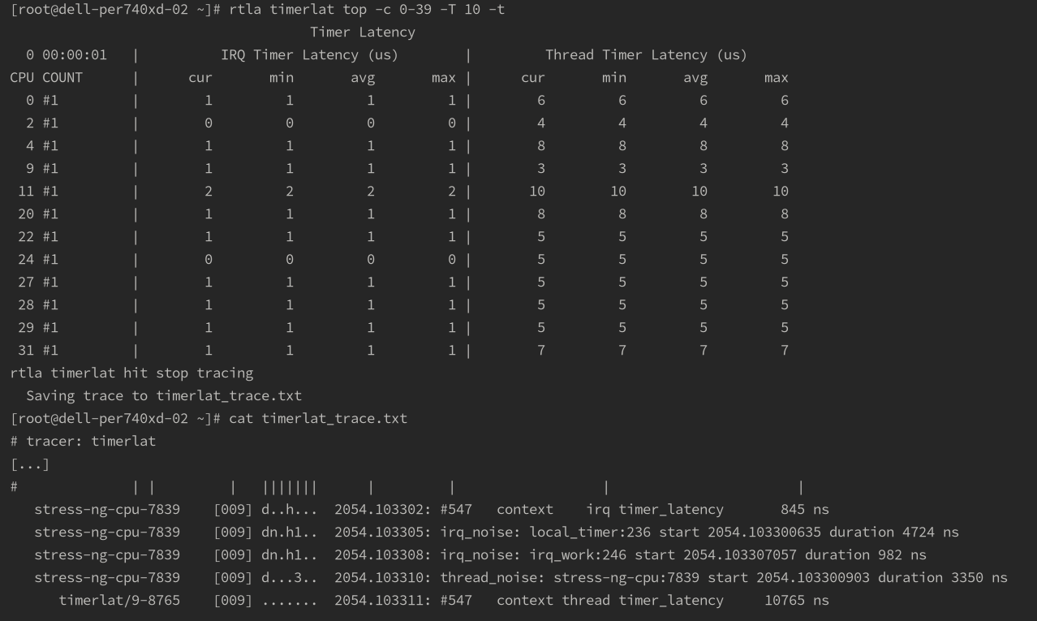
Find the spike
Userspace package rtla

Slide 21
Reference
https://docs.kernel.org/trace/osnoise-tracer.html
https://docs.kernel.org/trace/timerlat-tracer.html
https://www.computer.org/csdl/journal/tc/2023/01/09812514/1ECXVPwHQ4M

Slide 22
谢谢！

